Slide 1
Grey Hats at UH Manoa
Fall 2016

Slide 2
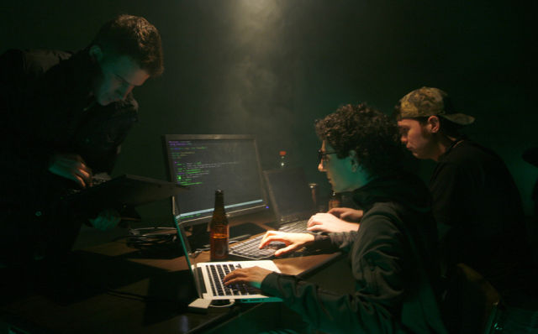
The Board
Redacted -President
Redacted -Vice President
Redacted -Vice President
Redacted -Secretary, facebook

Slide 3
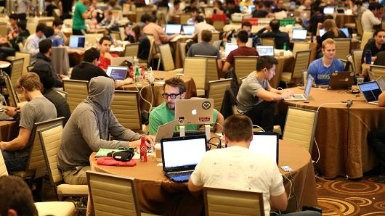
Fall Goals
-Compete in National Cyber League -Compete in monthly CTFs -Have bi-monthly tech talks -Build foundation for spring competitions; CCDC and Hawaiian Telcom CTF

Slide 4
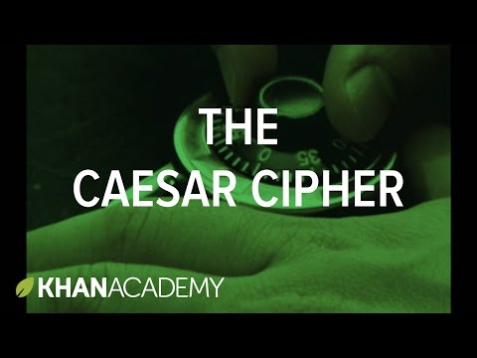
Challenge Solution
4 letter shift Caesar cipher
Cipher text: GSRKVEHYPEXMSRW SR HIGMTLIVMRK XLMW QIWWEKI M LSTI XS WII CSY EX SYV JMVWX QIIXMRK
Original text: CONGRADULATIONS ON DECIPHERING THIS MESSAGE I HOPE TO SEE YOU AT OUR FIRST MEETING

Slide 5
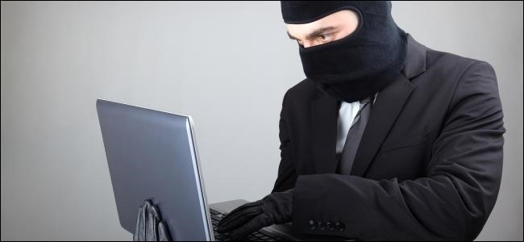
Important Dates
Tech Talk: You, Me, and the Magic Smoke - An Introduction to Electromechanics and Semiconductors
CTF: CSAW CTF Quals 16SEP
NCL Registration: Ends 23OCT
Getting Started: https://github.com/uhmgreyhats/getting-started

